Slide 1
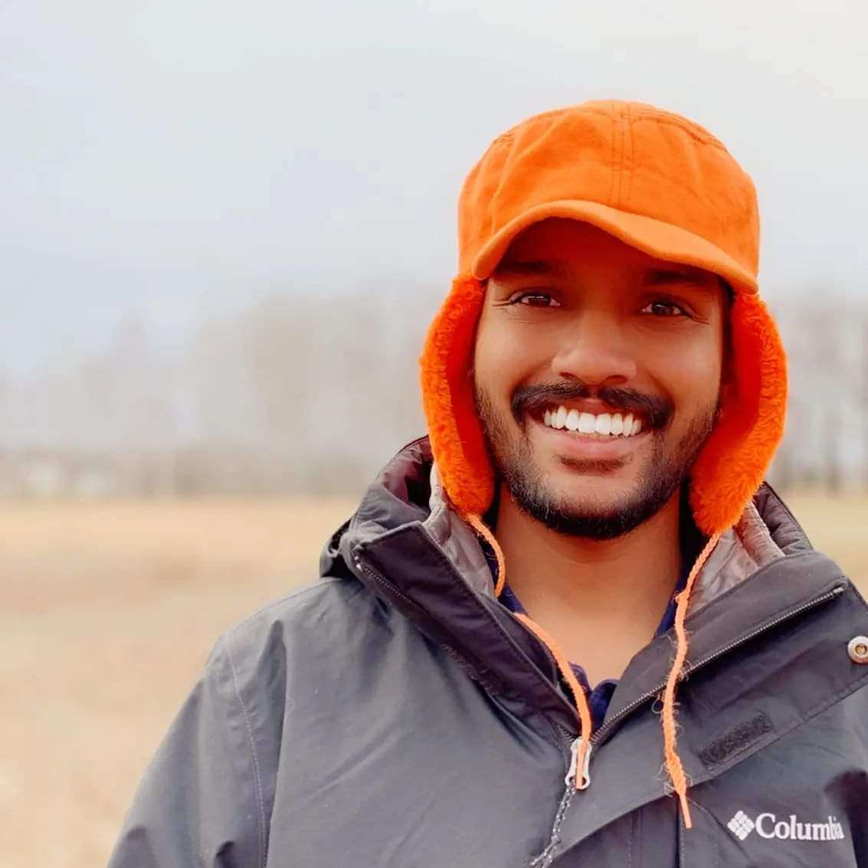

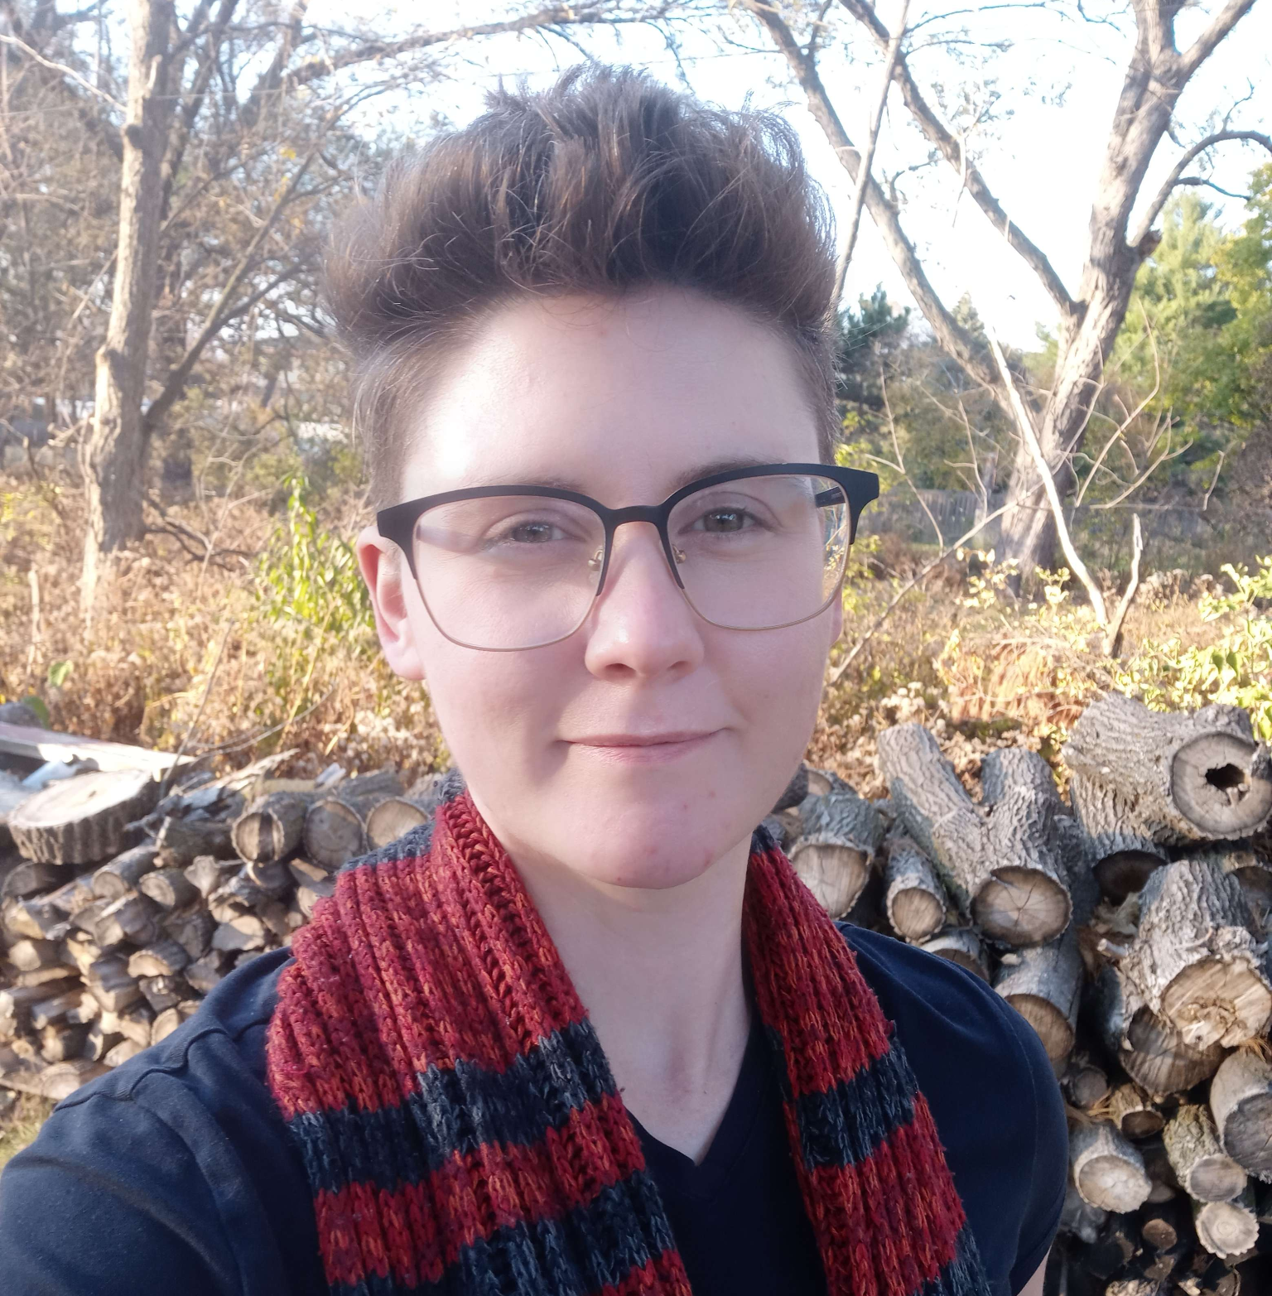
INTERIM project status of Passive Microwave Retrieval of Snow Density and VOD using SMAP Satellite observations
By Group 4 - Silas Kati, Divya Kumawat, Destiny Ziebol
Notes:
Hello everyone, we are group 4 constituting Silas, Destiny and myself Divya. This is our Interim project status for Passive Microwave Retrieval of Snow Density and VOD using SMAP observations.

Slide 2
Outline
Refresher of project
Datasets
What we have tried so far:
Ridge regression
Decision Tree - Effects of Normalization and Standardization
Random Forest
DNN
Comparison of Models
Future Works
LSTM
CNN
Additional Data
Comparison to Ground Truth
Notes:
The outline of our presentation will be as follows, we will start with a quick refresher introduction of the project, followed by the datasets which we will be using and the preprocessing steps which we took to prepare our data for the machine learning models.
We have tried 4 models so far, Ridge regression, Decision Trees, Random forest and DNN and we compare the performance of all these 4 models in establishing the relationship between our input and output variables.
We conclude this presentation by stating our future plan of this project.

Slide 3
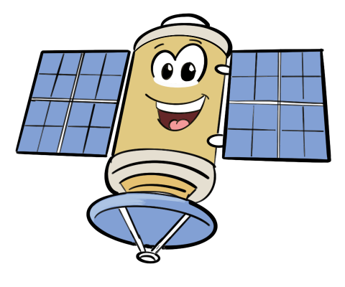
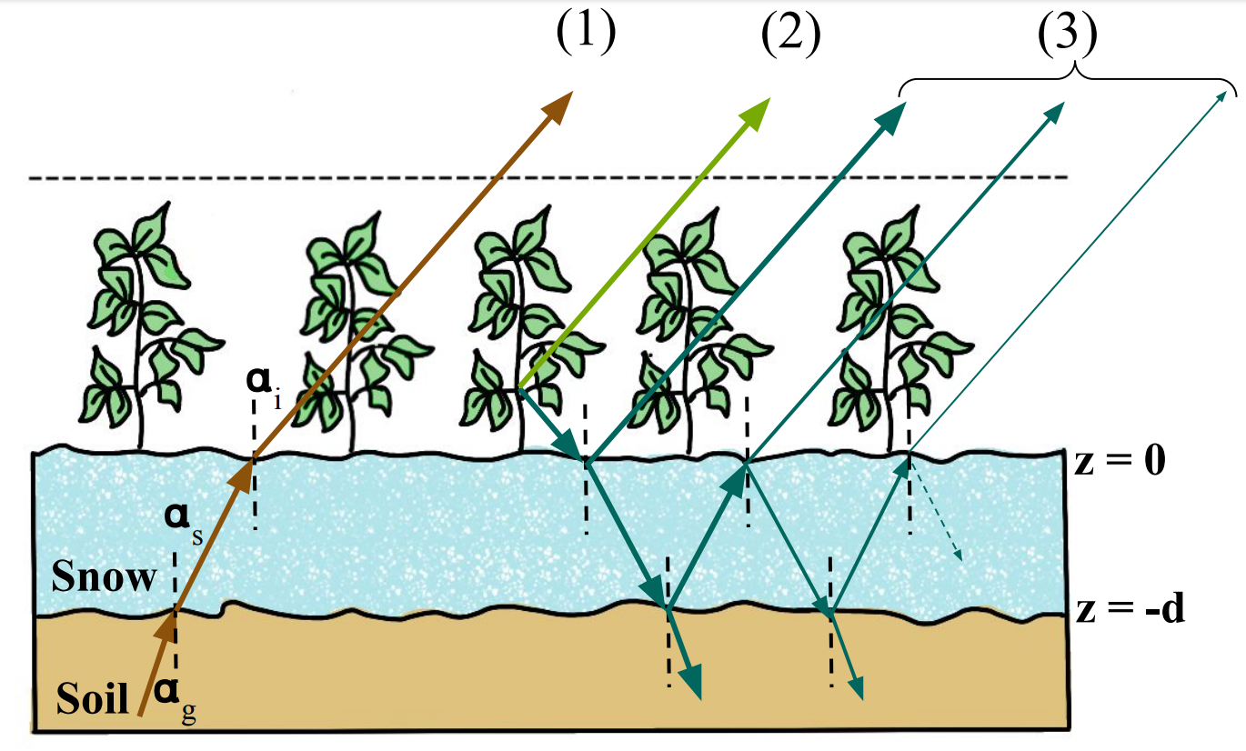
Hypothesis
We hypothesize that Snow Density can be sensed in the L-band. The rationale is that dry snow is a low-loss medium in L-band, which will affect how much signal is received by the satellite from underlying soil.
2-S EM Physics Based Model
Notes:
So as a quick refresher, Our project is utilizing data collected from the SMAP satellite.. Soil emits a signal received by the satellite. Snow refracts this signal, with higher density changing the angle more acutely. This influences the signal received by the satellite.
In this study we hypothesize that: Snow Density can be sensed in L-band. The rationale is that the dry snow is a low-loss medium in L-band i.e snow does not emit or absorb signal from the underlying soil, but it still does affect the signal due to the phenomenon of refraction.
Hence the signal observed by the satellite will be sensitive to snow density.
And this behaviour is simulated by the physics based model called 2 Stream Emission model.

Slide 4
Problem Statement
Currently, Ground observation data is used to understand the spatiotemporal heterogeneity of snow density, but it is difficult to achieve large-scale monitoring due to the complex environment and limited number of stations.
There are no global observation products of snow density and vegetation optical depth (VOD).
SMAP satellite data currently includes freeze/thaw state, but does not monitor snow density.
Notes:
We are attempting to directly address these problems by utilizing SMAP data to predict VOD and snow density based on features that can be collected globally, and therefore produce the first global estimates of VOD and faster, more efficient snow density estimation.

Slide 5
Abstract Representation of the Physical Model
Inverse Modeling: Given observation (y_{t}) and static characteristic (s_{t}) , determine the input drivers (x_{t})
Inverse Modeling
Input/ Driver Features (x_{t}):
(i) Snow Density
(ii) Vegetation Optical Depth
(ii) Ground Temperature
(iv) Temperature of Vegetation
Output (y_{t}) :
(i) Brightness Temperature- (horizontal polarization)
(ii) Brightness Temperature (vertical polarization)
Forward Model
F (x_{t} , s)
Input/ Static Features(s):
(i) Roughness Coefficient
(ii) Single scattering albedo
Notes:
We will be using this inverse model framework to predict snow density and VOD, utilizing input parameters given the observations from the satellite and a priori information for all other parameters.
And we aim to solve this inverse problem framework using Deep Learning Techniques.

Slide 6
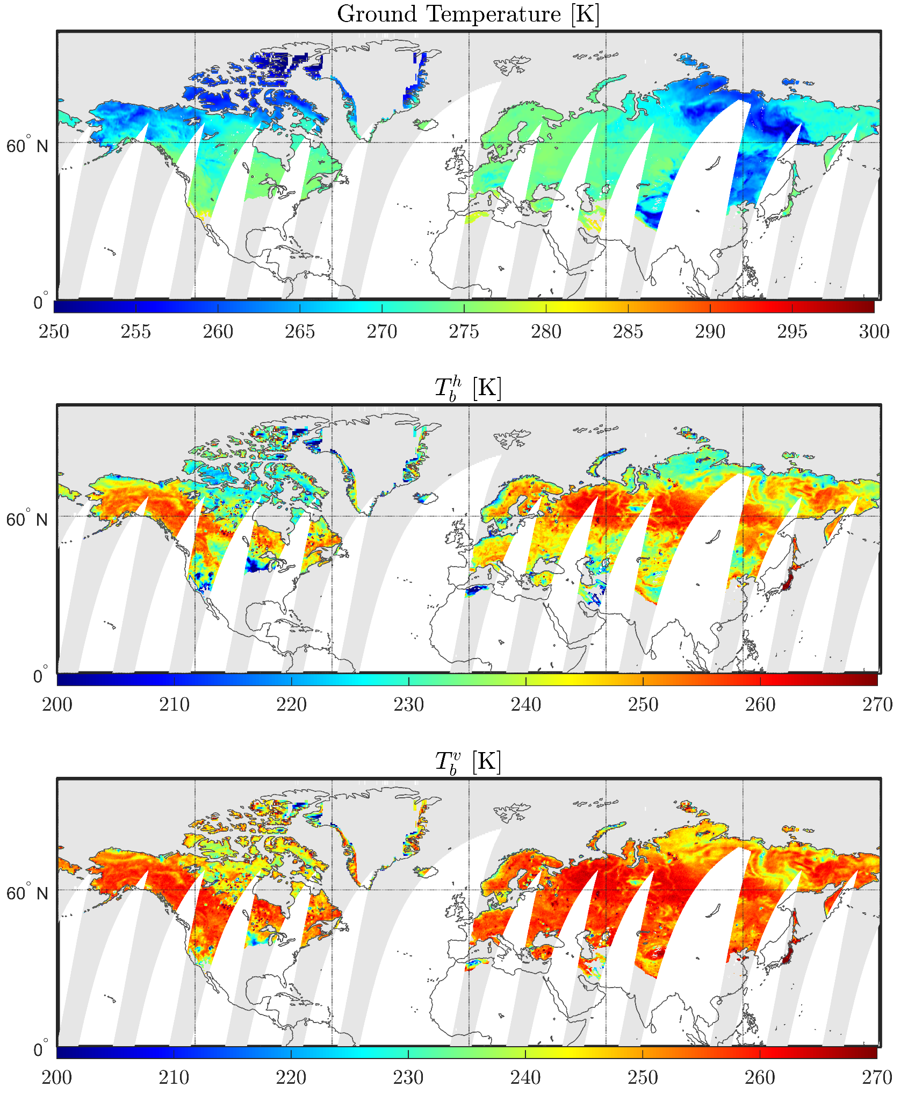
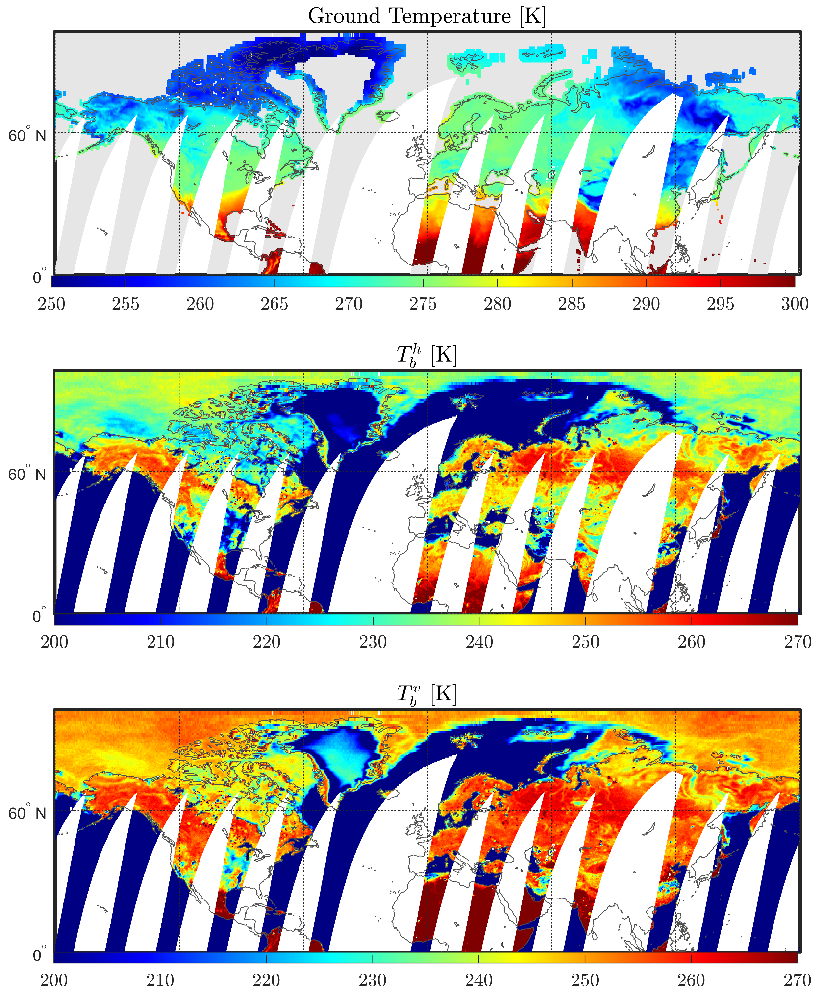
Datasets
Data Preprocessing
Extract all snow-covered areas
Notes:
This slide shows the raw satellite data which includes the brightness temperature sensed by the SMAP satellite and the corresponding processed pixels.
The raw data in the left was cleaned to include only those areas that included snow cover. Pixels with missing data were removed, and time period was limited to 2019 for our training set, and 2020 for our test set. Here we see three variables pictured: Ground temperature, and the two polarized bands of brightness temperature.

Slide 7
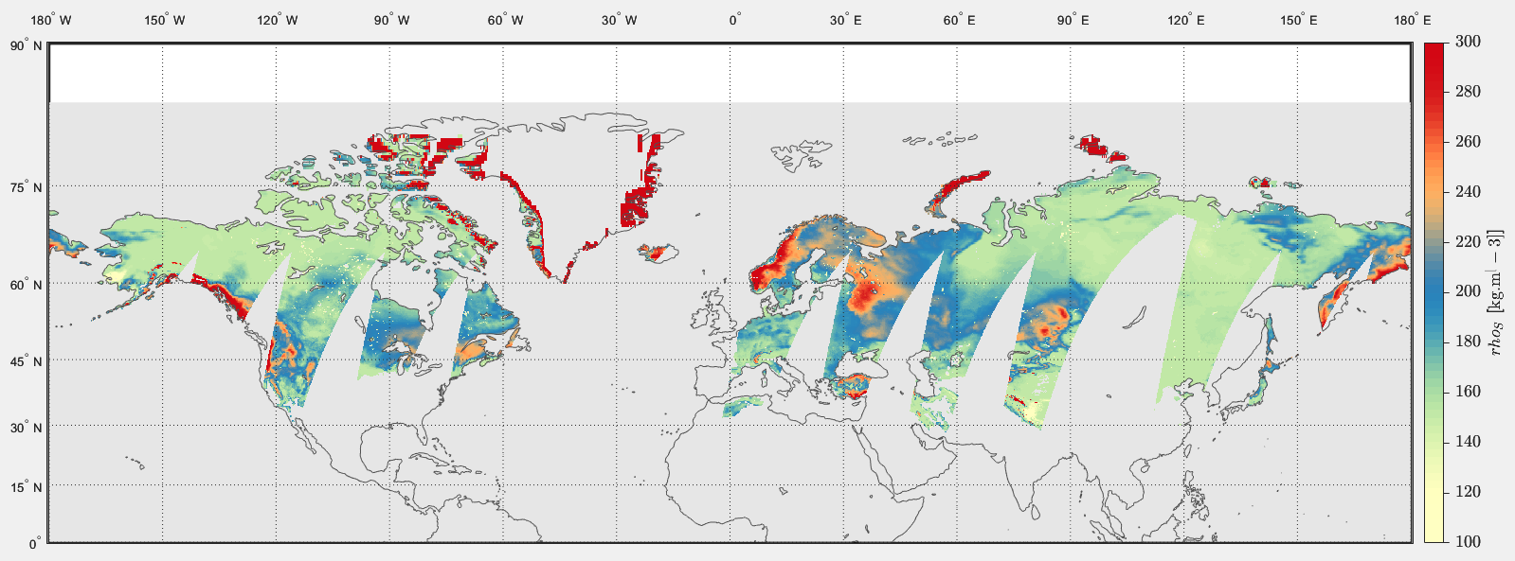
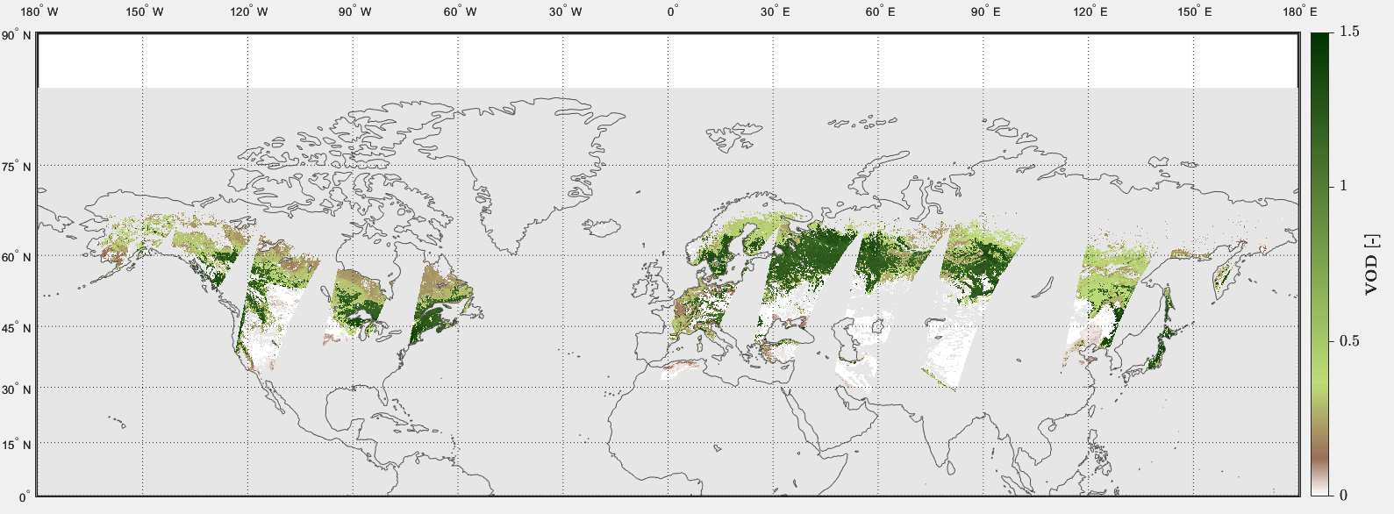
Datasets
Dynamic Input Predictors
Output Variables
Snow- Density
VOD
Static Input Parameters
Notes:
Now for these selected pixels, static input parameters were also added to our data set, to augment the dynamic inputs collected by SMAP. So, the final dataset included both static and dynamic variables for each location and time. This data set was used to predict both snow density and VOD variables as shown in the slide.

Slide 8
Method
Try different models which could learn the relationship between our input and output parameters
Ridge Regression
Decision Trees
Random Forest
DNN
Take 2019 data as train and validate (80/20). Test on 2020.
Notes:
This first stage of our project has been on searching for the best performing model types for our problem. We have made 4 models based on those used in the literature: ridge regression, decision trees, random forest, and deep neural networks. We cleaned data to remove NANs and used the entire global set from 2019 as train and validate, and the 2020 data as test.

Slide 9
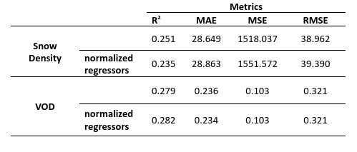
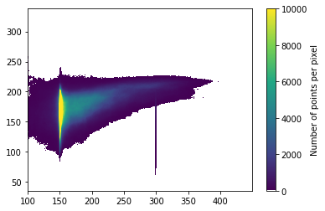
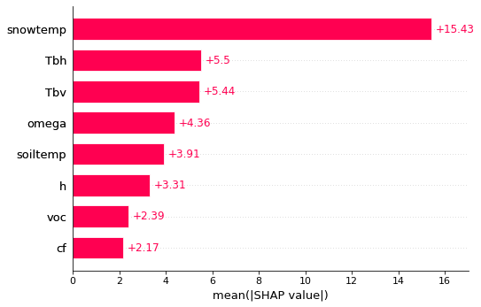
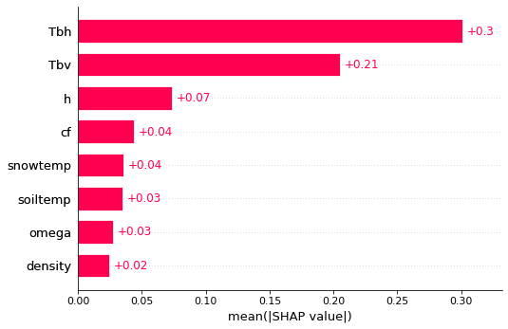
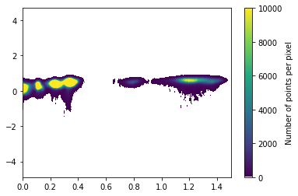
Ridge Regression:
RR Snow Density, Normalized, y test vrs predicted.
RR VOD, Normalized, y test vrs predicted.
RR Snow Density, Normalized, SHAP feature importance.
RR VOD, Normalized, SHAP feature importance.
Notes:
First we tried Ridge regression - a linear modeling technique, differing from linear regression only in the presence of an additional weighting coefficient designed to prevent overfitting. Based on the physical model, snow density estimation from our parameters is not a linear process, and our model did not perform well. We used SHAP feature analysis to clarify which features the model was using most heavily in it’s predictions, however, SHAP was prohibitively computationally expensive for our more complex models.

Slide 10
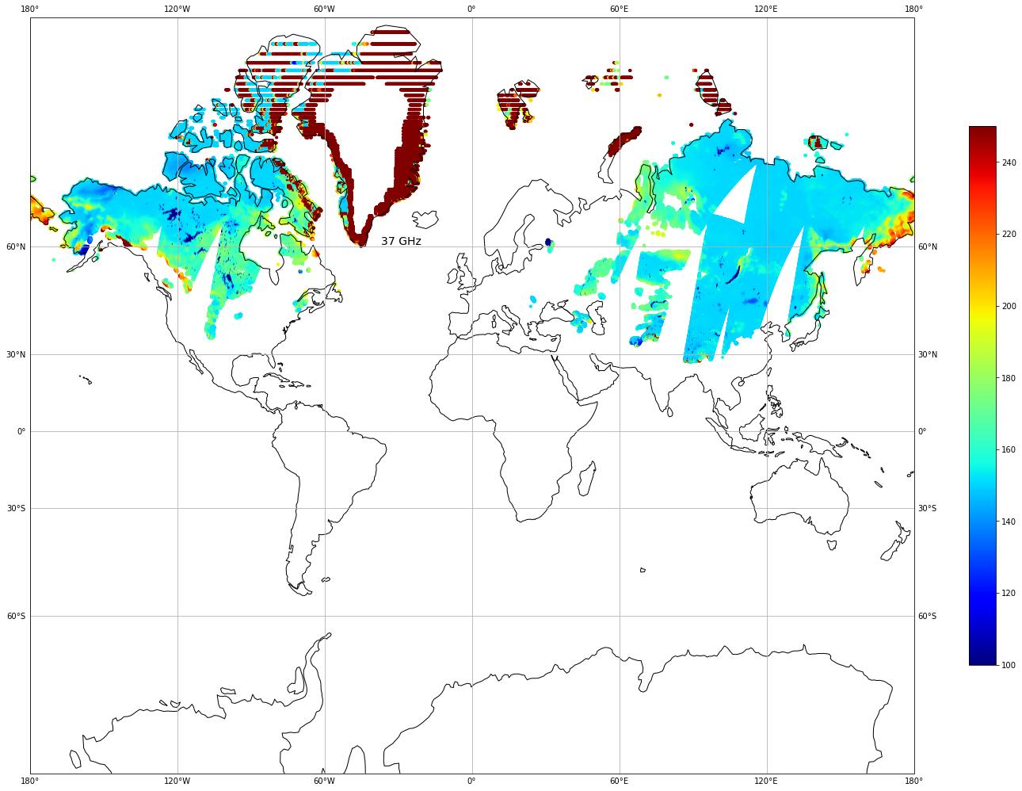
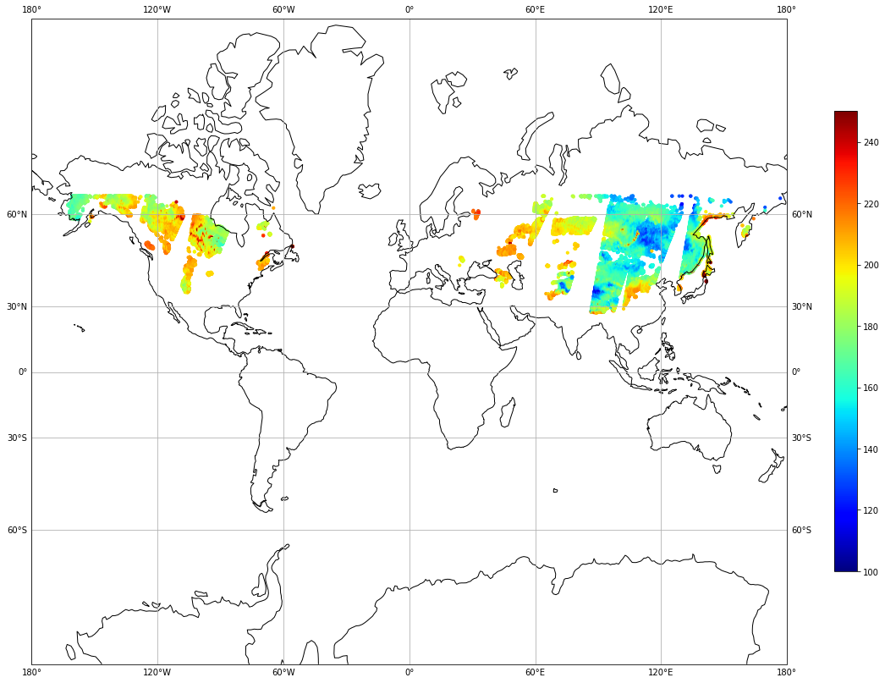
Ridge Regression, Snow Density, 2020-01-01:
Actual Plot of SD
y_pred plot for SD (RR)
Snow Density
Notes:
Here is a comparison of the snow density predictions from our normalized ridge regression model for snow density. For all of our map slides, left is ground truth, right is prediction. All maps are made for January First, 2020.

Slide 11
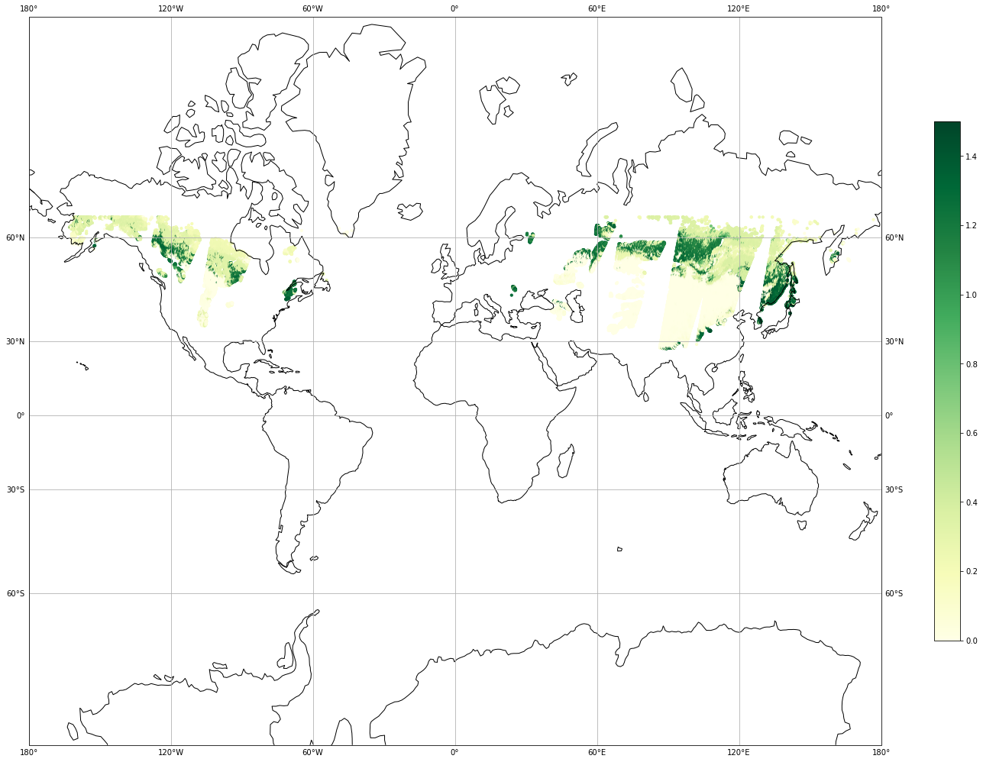
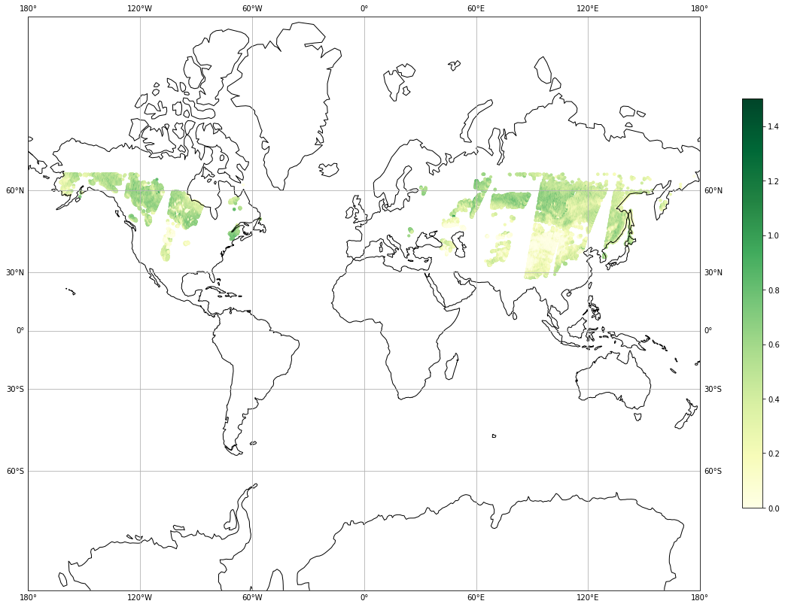
Ridge Regression, VOD, 2020-01-01:
Actual Plot of VOD
y_pred plot for VOD (RR)
VOD
Notes:
Here is a comparison of the predictions of our normalized ridge regression model for VOD.

Slide 12
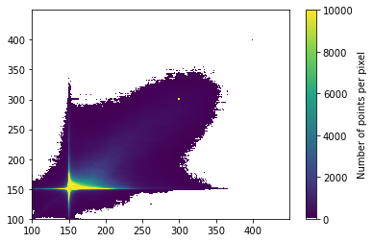
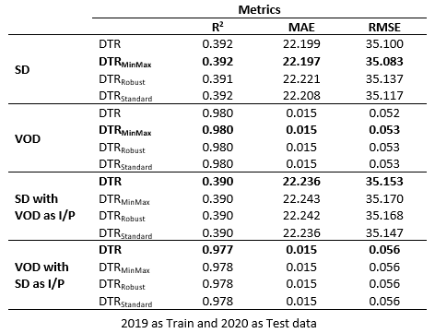
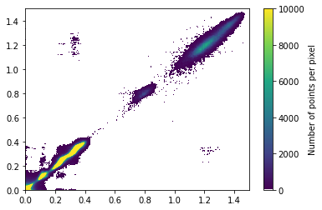
Decision Trees
y_test vs y_pred for SD with VOD as I/P (DTR)
y_test vs y_pred for VOD with SD as I/P (DTR)
Notes:
Since the linear model did not work for our problem, we tried decision tree regression which is a non-linear model.
We also examined how scaling affects the performance of decision tree regressors. The table here has all the results and the values are very similar to all the combinations we tried. Performance was also nearly unchanged by adding VOD as input when predicting SD and SD as input when predicting VOD.

Slide 13
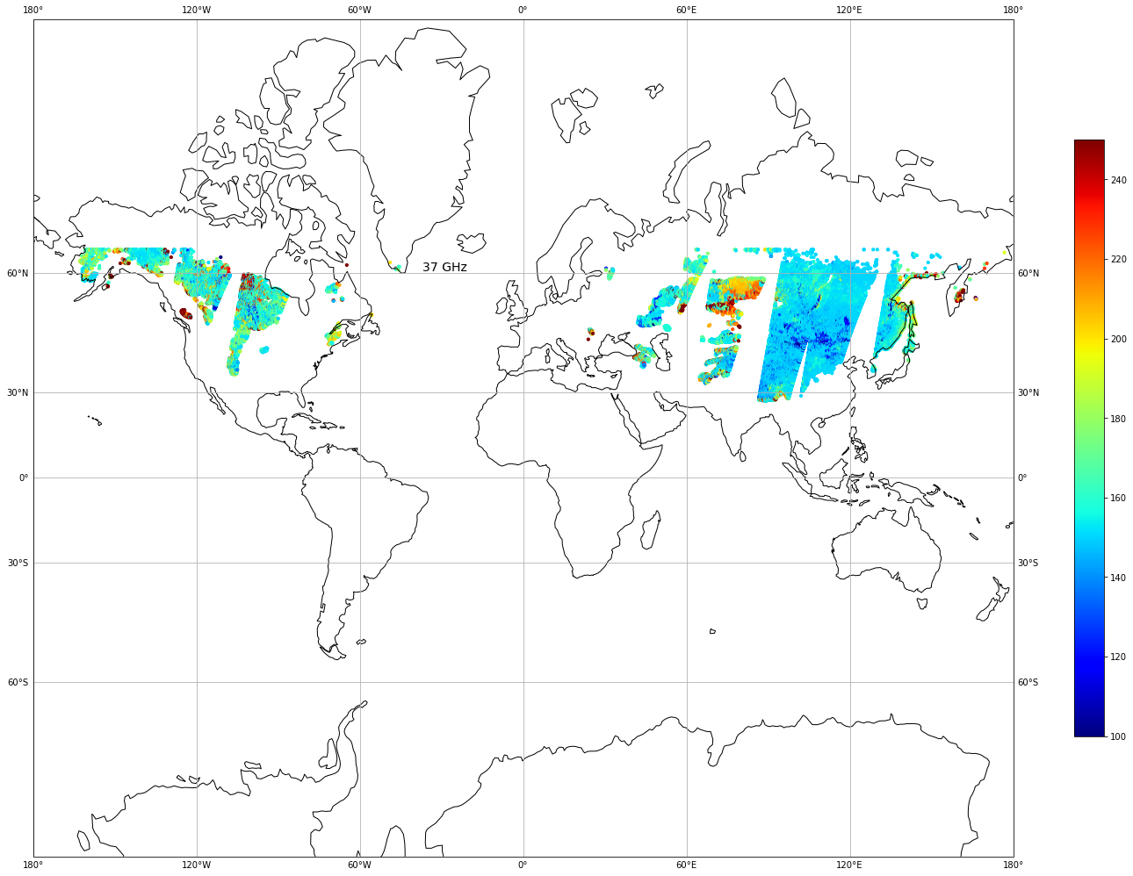
Decision Tree, Snow Density, 2020-01-01:
Actual Plot of SD
y_pred plot for SD with VOD as I/P (DTR)
Snow Density
Notes:
Here we have plotted the snow density prediction from our unscaled version of decision tree model that includes VOD as a predictor.

Slide 14
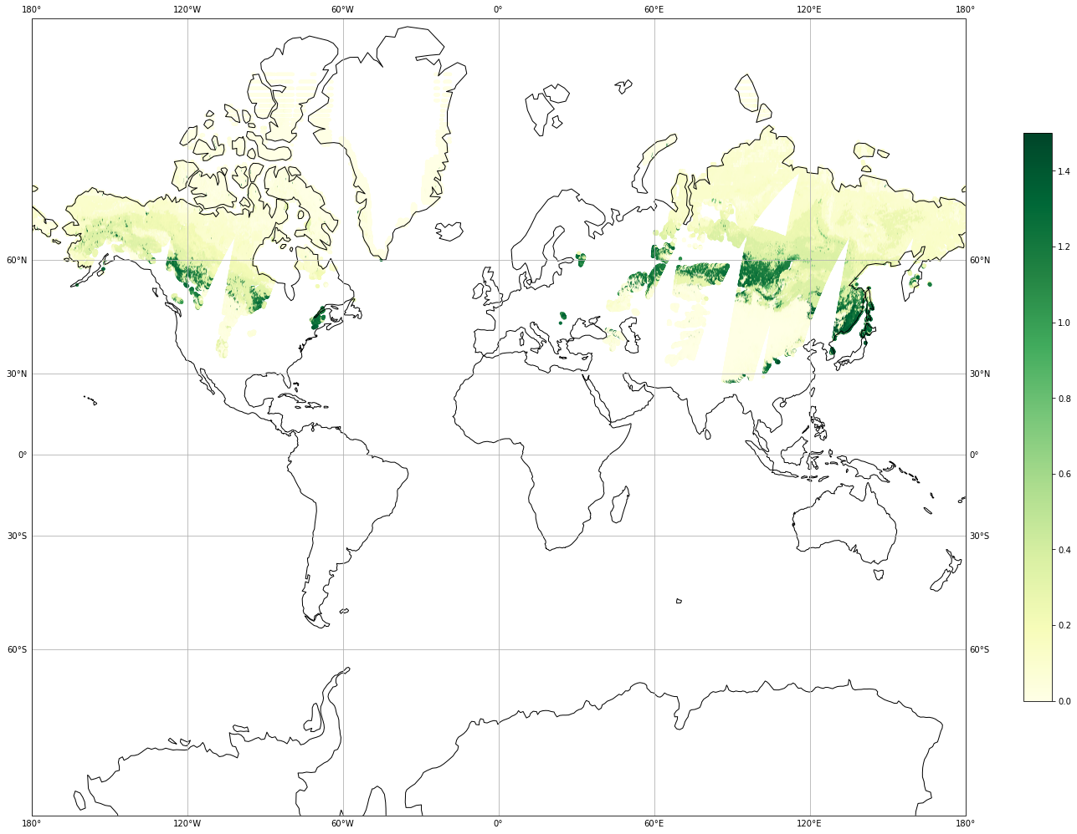
Decision Tree, VOD, 2020-01-01:
Actual Plot of VOD
y_pred plot for VOD with SD as I/P (DTR)
VOD
Notes:
Here is a map of our VOD predictions using our unscaled decision tree model that includes snow density as a predictor. Notice how we are able to get predictions beyond where we have actual VOD data.

Slide 15
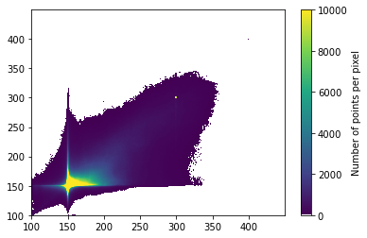
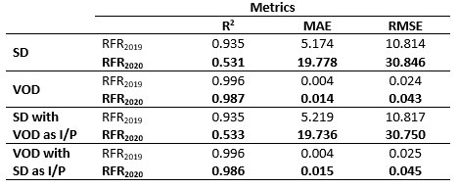

Random Forest
y_test vs y_pred for SD (RFR₂₀₂₀)
y_test vs y_pred for VOD (RFR₂₀₂₀)
Notes:
Since DTR gave us a better performance than Ridge Regressor, we tried RFR with the same combinations. We did not try any scaling methods here since the results with scaling in our previous example were similar. This table lists the comparison in performances when trained and tested on year 2019 only and when trained on 2019 and tested on 2020. We see that the RFR has improved results on SD compared to DTR. Same as with the decision tree models, we see identical performances between models when SD and VOD are given as inputs.

Slide 16
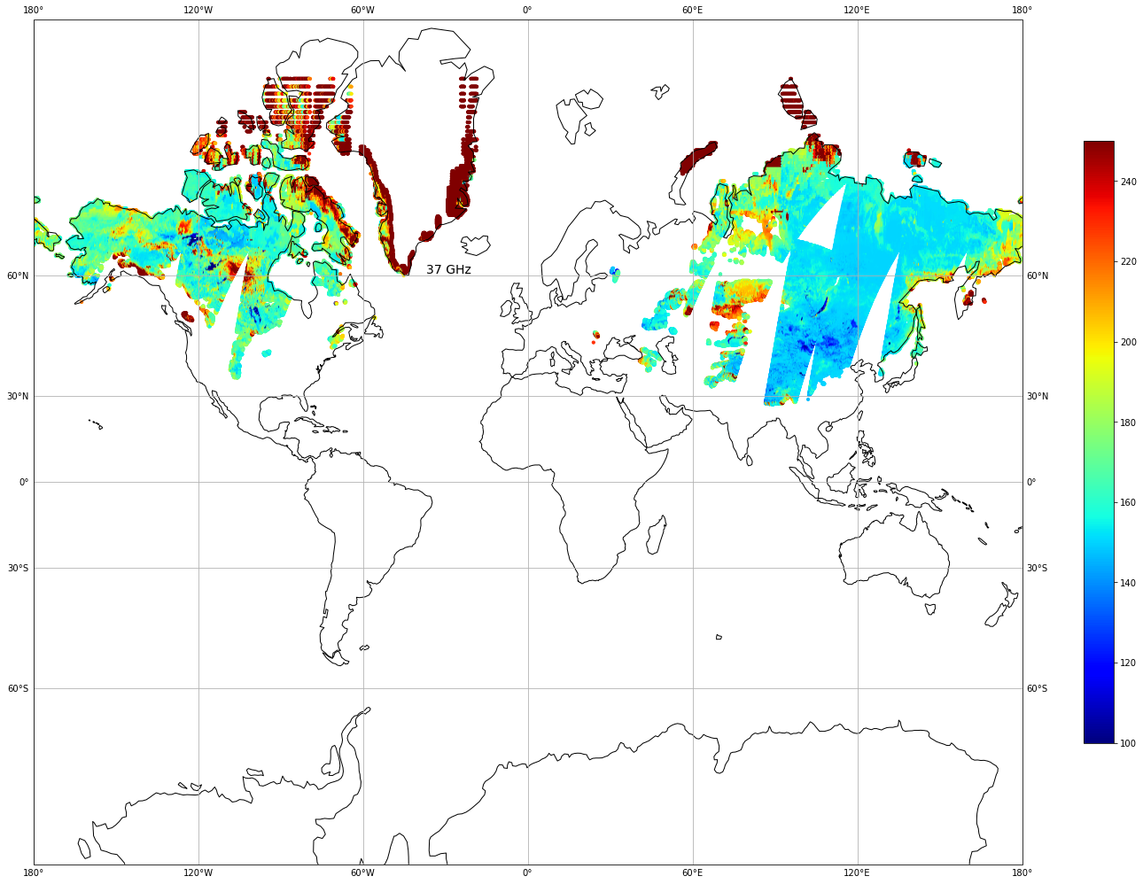
Random Forest, Snow Density, 2020-01-01:
Actual Plot of SD
y_pred plot for SD with VOD as I/P (RFR₂₀₂₀)
Snow Density
Notes:
Here you can compare our predicted values for snow density, using the random forest model that includes VOD as a predictor variable.

Slide 17
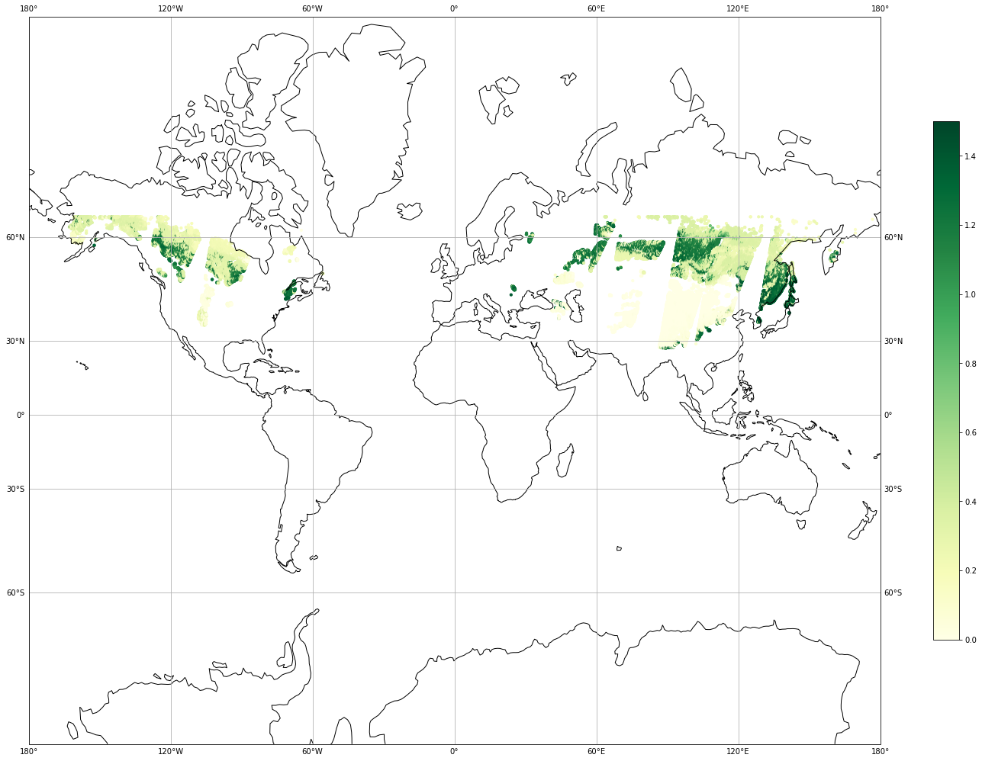
Random Forest, VOD, 2020-01-01:
Actual Plot of VOD
y_pred plot for VOD with SD as I/P (RFR₂₀₂₀)
VOD
Notes:
And here we have our predicted VOD from our random forest model with snow density as a predictor.

Slide 18
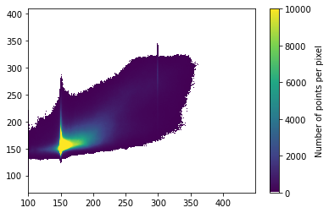
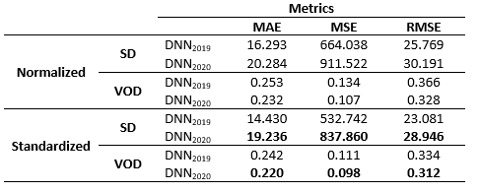
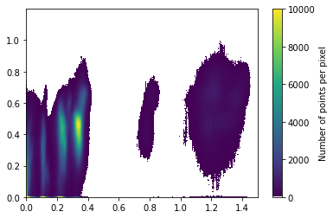
DNN
y_test vs y_pred for SD standardized (DNN₂₀₂₀)
y_test vs y_pred for VOD standardized (DNN₂₀₂₀)
Notes:
Next, we tried a Sequential DNN which had 6 hidden layers and used relu as the activation function. In this network we can predict Snow Density and VOD together.
This DNN performed better when i/p variables were standardized. Also, we achieved slightly better results for SD than our previous models.

Slide 19
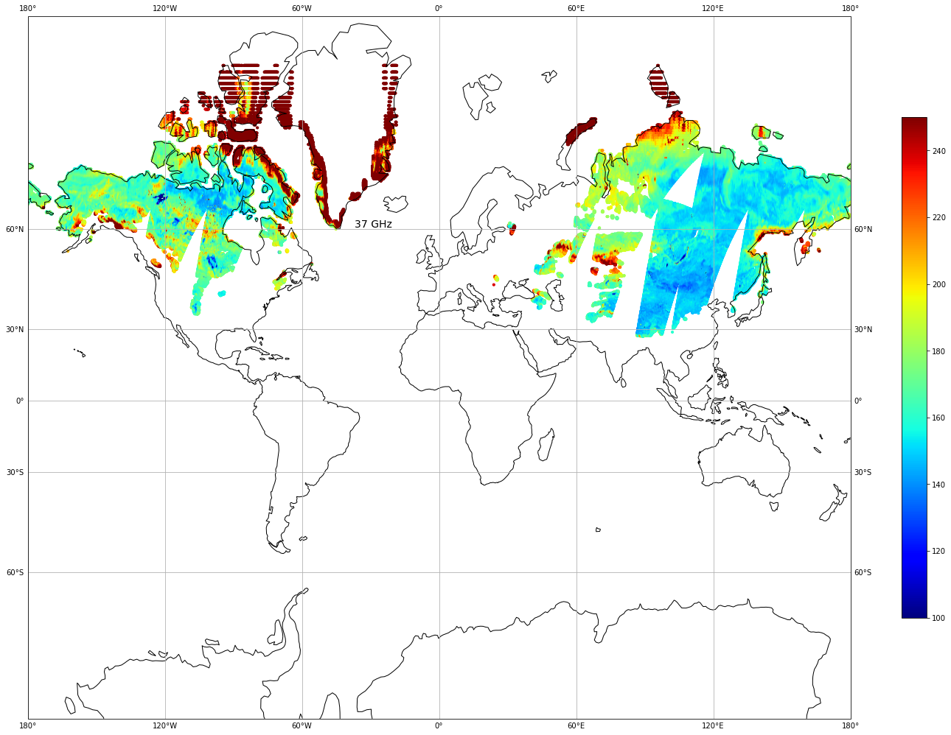
DNN, Snow Density, 2020-01-01:
Actual Plot of SD
y_pred plot for SD standardized (DNN₂₀₂₀)
Snow Density
Notes:
Here you can see the snow density predictions from our DNN with standardized inputs, as compared to ground truth on the left.

Slide 20
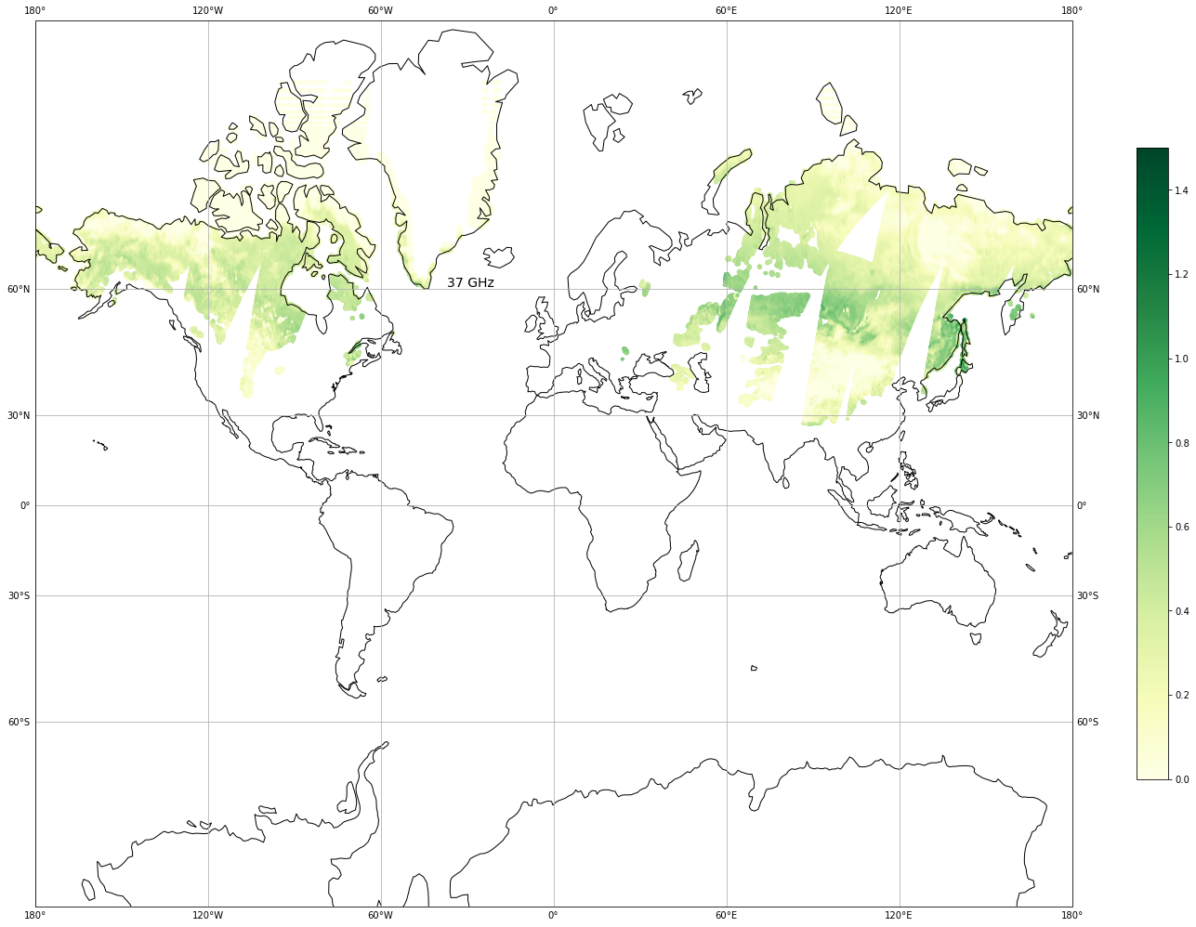
DNN, VOD, 2020-01-01:
Actual Plot of VOD
y_pred plot for VOD standardized (DNN₂₀₂₀)
VOD
Notes:
And here is the VOD predictions from our DNN with standardized inputs.

Slide 21
Summary
Models - Snow Density | R^2 | MAE | RMSE
Ridge Regression (not normalized) | 0.235 | 28.8 | 39.3
Decision Trees (min/max, no VOD) | 0.392 | 22.197 | 35.083
Random Forest (with VOD) | 0.533 | 19.736 | 30.750
DNN (standardized) | 0.681 | 19.236 | 28.946
Models - VOD
Ridge Regression (normalized) | 0.282 | 0.234 | 0.321
Decision Trees (min/max, no SD) | 0.980 | 0.015 | 0.053
Random Forest (no SD) | 0.987 | 0.014 | 0.043
DNN (standardized) | 0.280 | 0.220 | 0.312
Notes:
So to summarize, our goal at this stage of the project was to determine the best model which could establish relationship between our input and output parameters for Snow Density and VOD. Based on our results, the dense neural network performed best for predicting Snow Density, and the random forest performed best for predicting VOD.

Slide 22
Conclusion
Goal is to get a RMSE below 30 kg/m^3 for SD
Ridge regression is linear and does not work
Ensemble methods increase the performance of single ML models, such as Random Forest vs Decision Trees
DNN predicts both variables at the same time, making it a desirable model if we can get high quality predictions for both SD and VOD
Notes:
Our goal was to get a snow density RMSE below 30 kg/m^3, which we have just achieved with our highest performing model. We found that non-linear methods worked well, and the linear Ridge Regression model was ill-suited for this task. By employing an ensemble method we were able to increase the performance of our random forest model, and we may employ this strategy again in the future. Our DNN model can predict both Snow Density and VOD simultaneously, although it is not the best performing model for VOD, this is still a desirable trait and we are working to increase model performance for VOD.

Slide 23
Research Breakthrough
In winter, there is no NDVI above 65 degrees north due to lack of light, and no VOD information due to snow.
Vegetation does exist in these areas despite the lack of data.
Our data utilizes passive microwave inputs that can be collected regardless of time of year and location.
By using our trained model on pixels below 65 degrees north we can predict VOD in complete absence of training data.
We would like to validate these predictions using proxy information such as leaf area index and tree height data.
Available VOD data
Predicted VOD data (RFR)
Notes:
In the process of developing our models, we realized that we would be able to predict VOD in areas beyond the presence of our data. - (read slide)

Slide 24
Future Works
CNN to predict better relationships between our predictor variables and target variables, to better utilize the spatial pattern of vegetation
LSTM
Use of Physical Model: KGML
Comparison from the ground-based dataset
Notes:
In our future works we would like to employ more neural networks, to build off of the success of our deep neural network. We would like to employ convolutional neural networks to better understand spatial relationships between attributes, and LSTM to take advantage of temporal relationships. We also have a physics based model that we can employ for knowledge guided ML, and can start comparing our predictions with ground truth data.

Slide 25
Thank you!
Questions?

